Slide 1
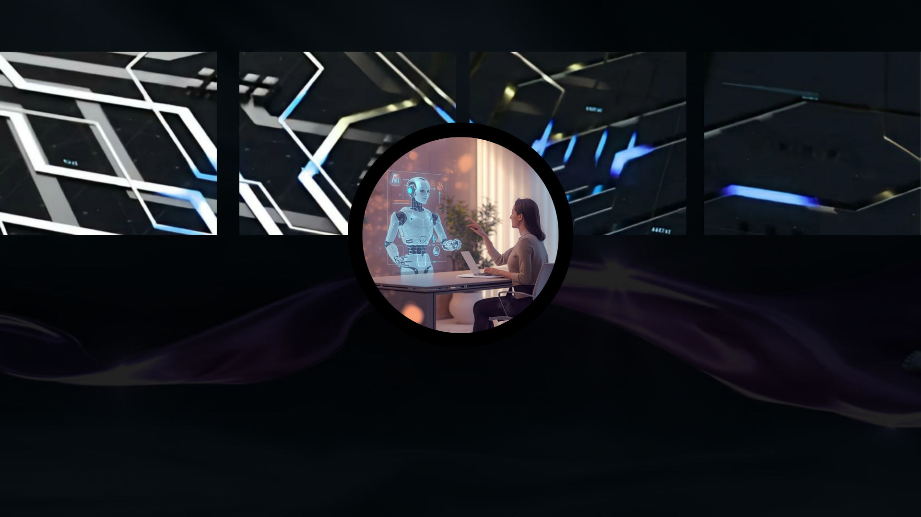
WELCOME
FUTURE VISION

Slide 2

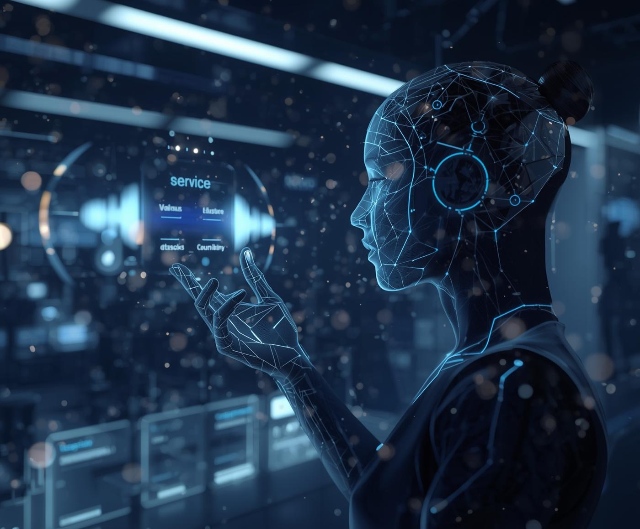
Virtual Assistant
Project Overview
Virtual AI Interview & Conversation Assistant
An intelligent, voice-driven virtual assistant designed for interviews, study discussions, and general conversation
Combines real-time speech recognition, AI-generated responses, and human-like visual presence
Designed to feel natural, responsive, and immersive, not like a chatbot
Focused on real-world usability, not just demo functionality
Key Goal:
Create a human-centric AI interaction experience that feels conversational, professional, and engaging.

Slide 3
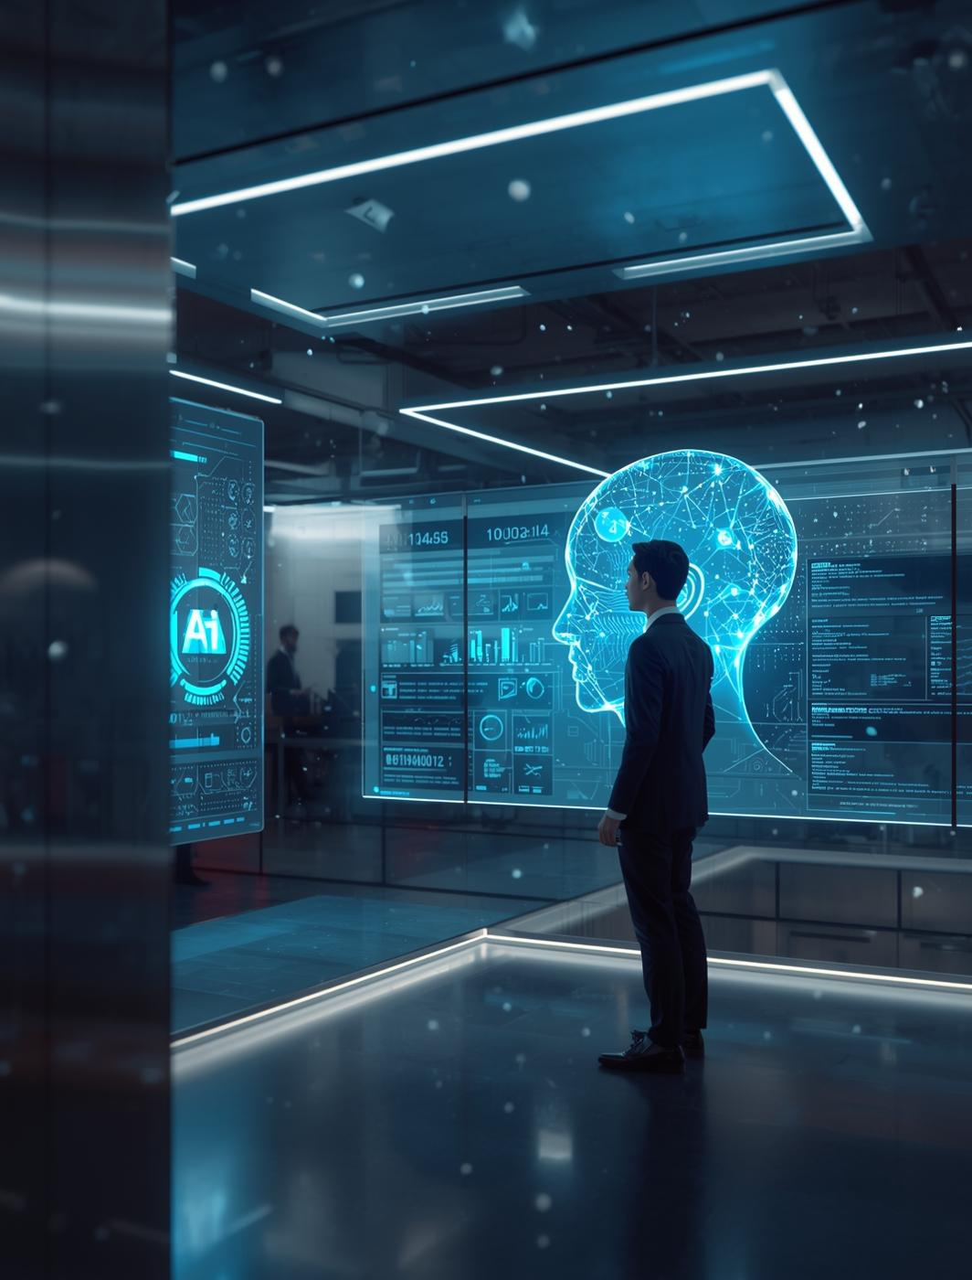
Problem Statement
Why Existing AI Assistants Fail
Most AI chatbots are text-only or feel robotic
Voice assistants lack visual feedback, reducing trust and engagement
Interview preparation tools are:
Static
Script-based
Non-interactive
Users disengage quickly due to unnatural interaction flow
Challenge:
How do we make AI conversations feel closer to human-to-human communication?

Slide 4
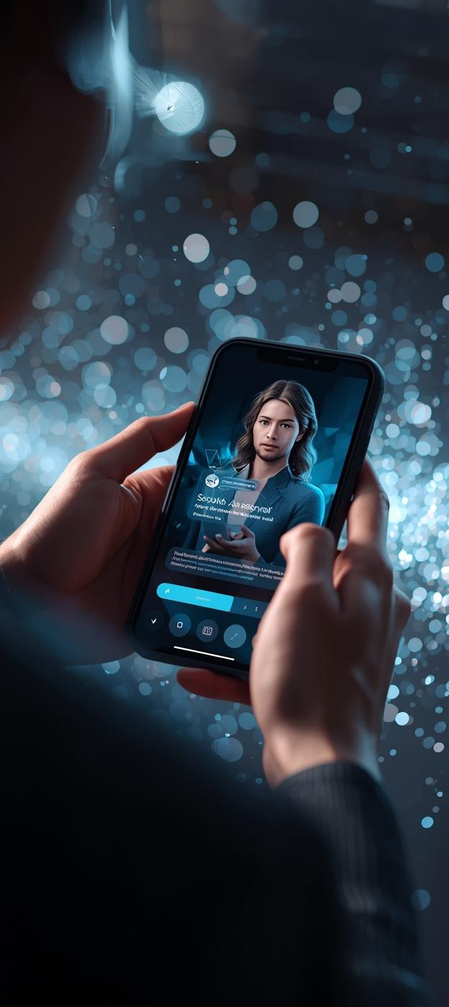
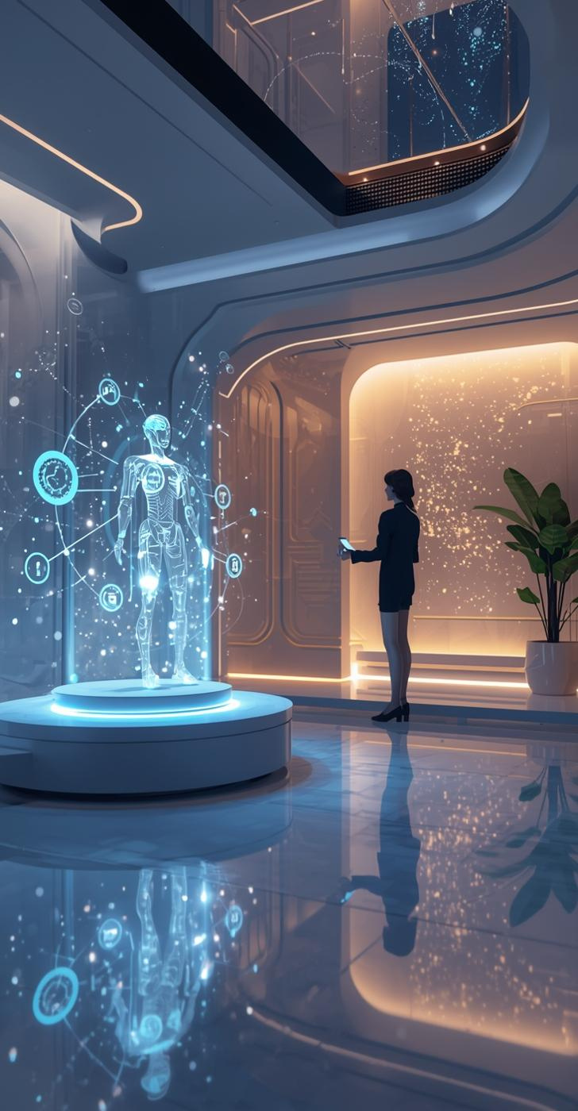
Solution Architecture
Our Approach
Voice-first interaction
=> User speaks naturally using the Web Speech API
Intelligent backend
AI processes user intent and generates contextual responses
Visual AI presence
Dynamic avatar video plays only while AI is speaking
State-driven synchronization
AI speaking → avatar animation plays
User speaking → avatar pauses (idle state)

Slide 5
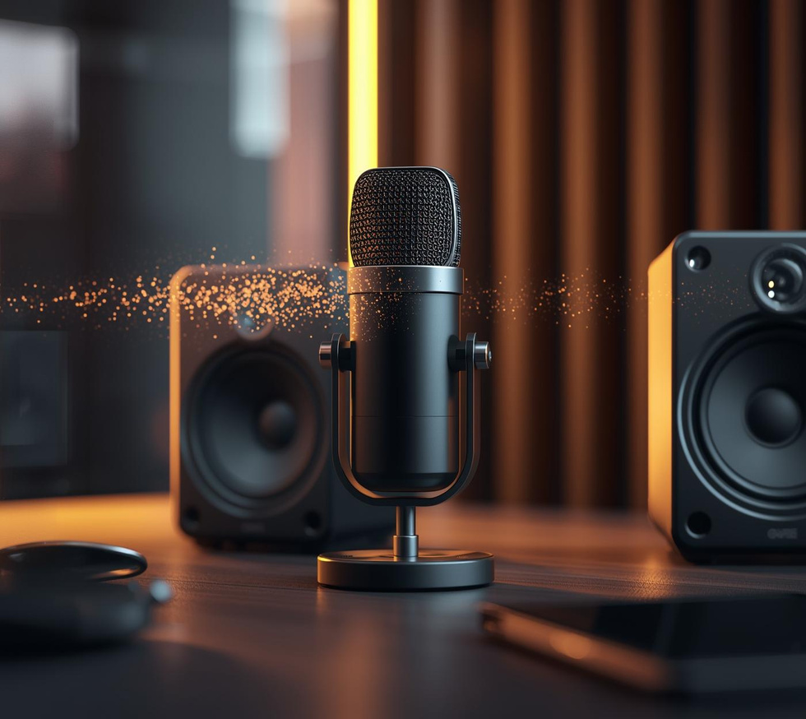

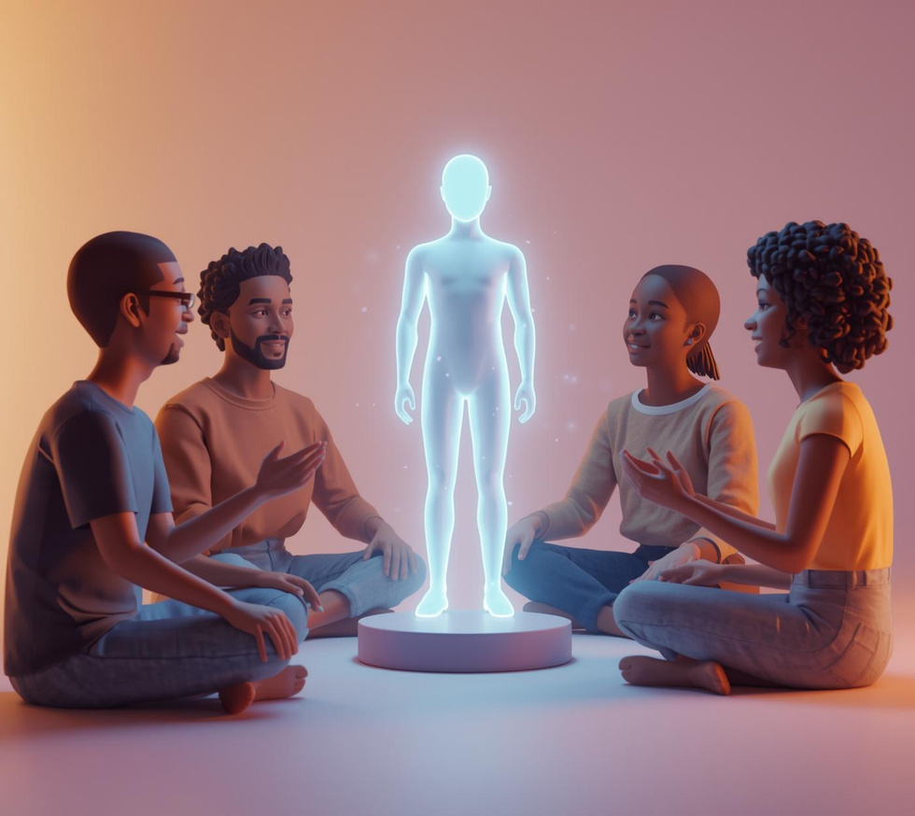
Key Innovations
No fake animations
Visuals are driven by real interaction states, not timers
Multi-mode intelligence
Interview mode
Study discussion mode
Casual conversation mode
Scalable design
Easily extendable to real lip-sync, 3D avatars, or AR/VR
Time-accurate avatar behavior
Avatar animation duration exactly matches AI speech duration

Slide 6

Impact & Future Scope
Real-World Applications
AI interview preparation platforms
Virtual tutors and study assistants
HR screening tools
Customer support avatars
Digital humans for education and training
Future Enhancements
Real-time lip-sync using ML
Emotion-aware responses
Personalized interview feedback
Multilingual support
XR-based AI avatars

Slide 7
Contact
Get in Touch with Our Team
EMAIL
chsuryachowdary12@gmail.com

